Slide 1
CNN LAYERS
Convolutional layers are the layers where filters are applied to the original image, or to other feature maps in a deep CNN. This is where most of the user-specified parameters are in the network. The most important parameters are the number of kernels and the size of the kernels.

Slide 2
The different layers of a CNN. There are four types of layers for a convolutional neural network: the convolutional layer, the pooling layer, Activation layer and the fully-connected layer.
1) Convolution layer
A convolutional layer contains a set of filters whose parameters need to be learned. The height and weight of the filters are smaller than those of the input volume. Each filter is convolved with the input volume to compute an activation map made of neurons.
Convolution is the first layer to extract features from an input image. Convolution preserves the relationship between pixels by learning image features using small squares of input data. It is a mathematical operation that takes two inputs such as image matrix and a filter or kernel.

Slide 3
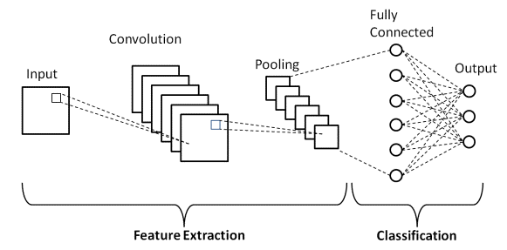
2) Activation layer A non-linearity layer in a convolutional neural network consists of an activation function that takes the feature map generated by the convolutional layer and creates the activation map as its output.

Slide 4
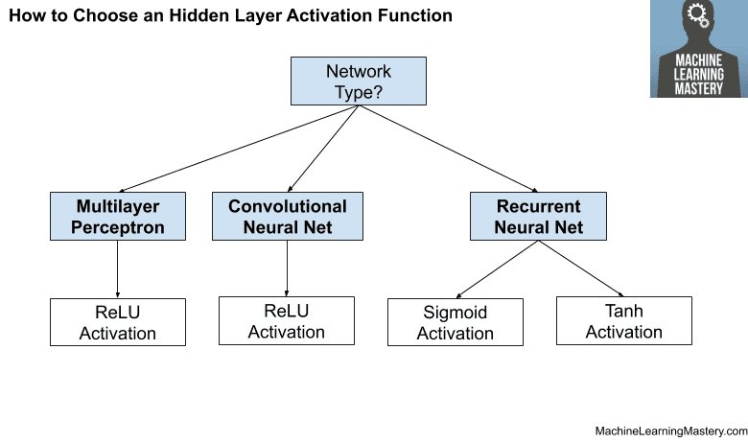
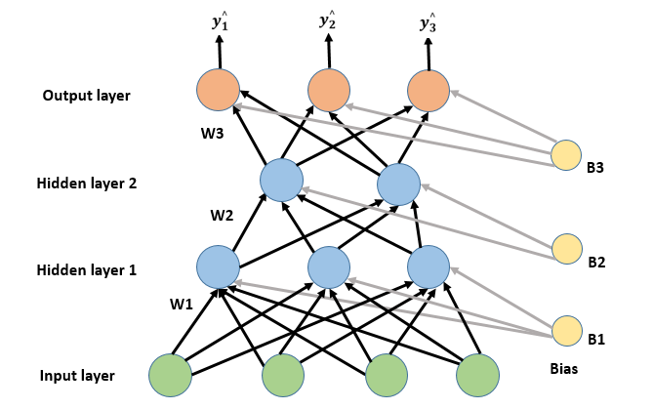
An activation function in a neural network defines how the weighted sum of the input is transformed into an output from a node or nodes in a layer of the network.

Slide 5
3) Pooling layer A pooling layer is a new layer added after the convolutional layer. Specifically, after a nonlinearity (e.g. ReLU) has been applied to the feature maps output by a convolutional layer; for example the layers in a model may look as follows: Input Image. Convolutional Layer.
Pooling layers are used to reduce the dimensions of the feature maps. Thus, it reduces the number of parameters to learn and the amount of computation performed in the network. The pooling layer summarises the features present in a region of the feature map generated by a convolution layer.

Slide 6
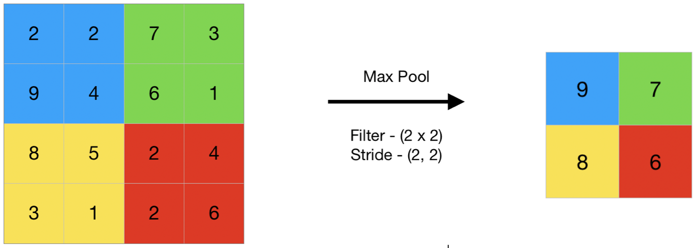
Pooling layer
4) Fully Connected layer
Fully Connected Layer is simply, feed forward neural networks. Fully Connected Layers form the last few layers in the network. The input to the fully connected layer is the output from the final Pooling or Convolutional Layer, which is flattened and then fed into the fully connected layer.

Slide 7
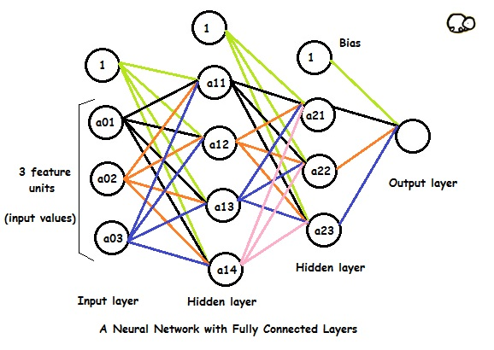
Fully Connected layers in a neural networks are those layers where all the inputs from one layer are connected to every activation unit of the next layer. In most popular machine learning models, the last few layers are full connected layers which compiles the data extracted by previous layers to form the final output.

